Slide 1
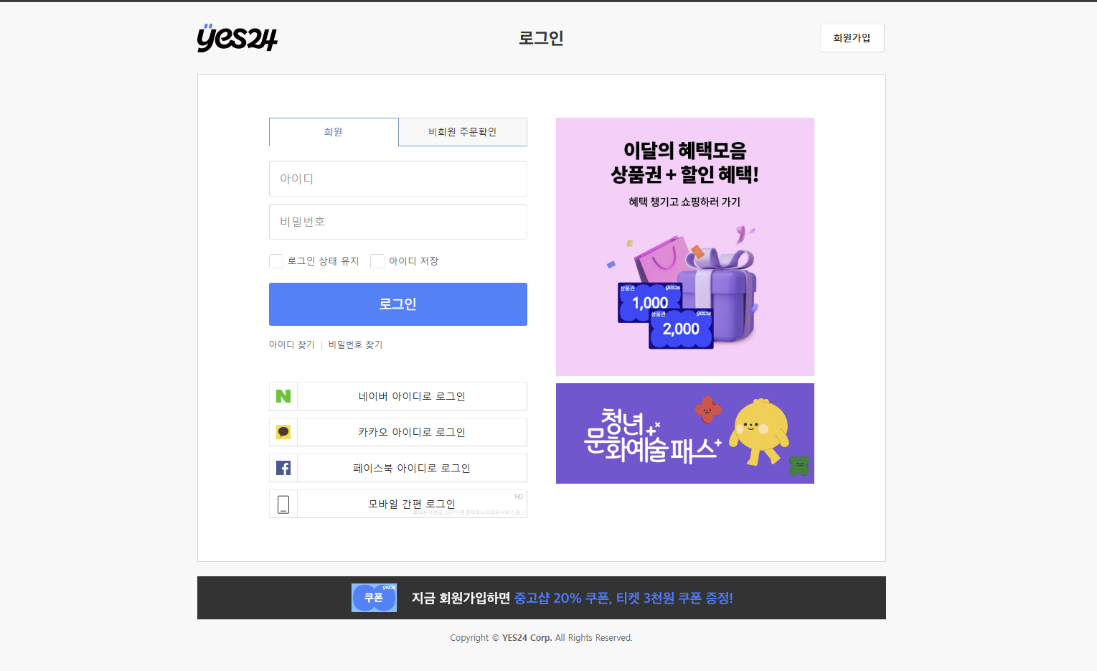
<header>
<main>
<section>
<article2>
<article1>
<footer>

